Slide 1
ESPN’s UI/UX Design re-iteration
Uskuu Batchuluun

Slide 2
PURPOSE OF THE Reiteration
Improving user friendly navigation on ESPN’S mobile app.
Understanding elements and features users tend to like and dislike, manipulating it to gain more website traffic on the app.
Create and explore designs most suitable for the company’s agenda, purpose, aesthetics and target demographic.
Tailor the existing app to the user demographic by establishing hierarchy of information needs.
Learning about the phases of user interface design, building from the ground up, through multiple phases.

Slide 3
Process phases
This project goes through 6 distinct phases
Starting with a paper prototype of what the navigation between pages is going to look like.
Then we bring that idea onto digital platform creating a general wireframe of the screens.
After feedback and reiterations, the final product is made at the end of Phase 6.
Phase 1
Paper Prototyping
Phase 2
Digital Wireframe
Phase 3
Phase 4
User feedback
Reiteration
Phase 5
Proper design grids
Phase 6
Final product

Slide 4
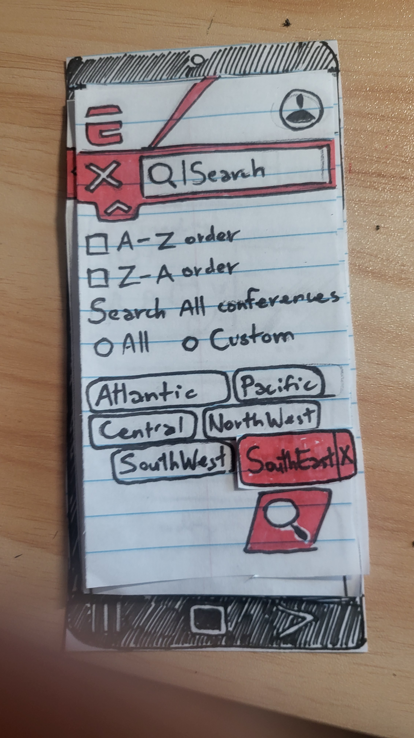
PHASE 1
Brainstorming ideas and fundamental elements necessary to envision the final product.
Paper prototyping is an efficient, low stakes way to establish the fundamental elements of the redesign.

Slide 5
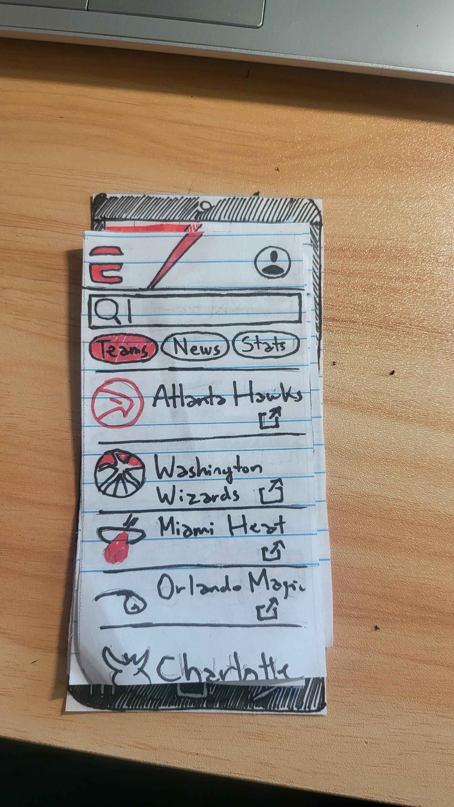
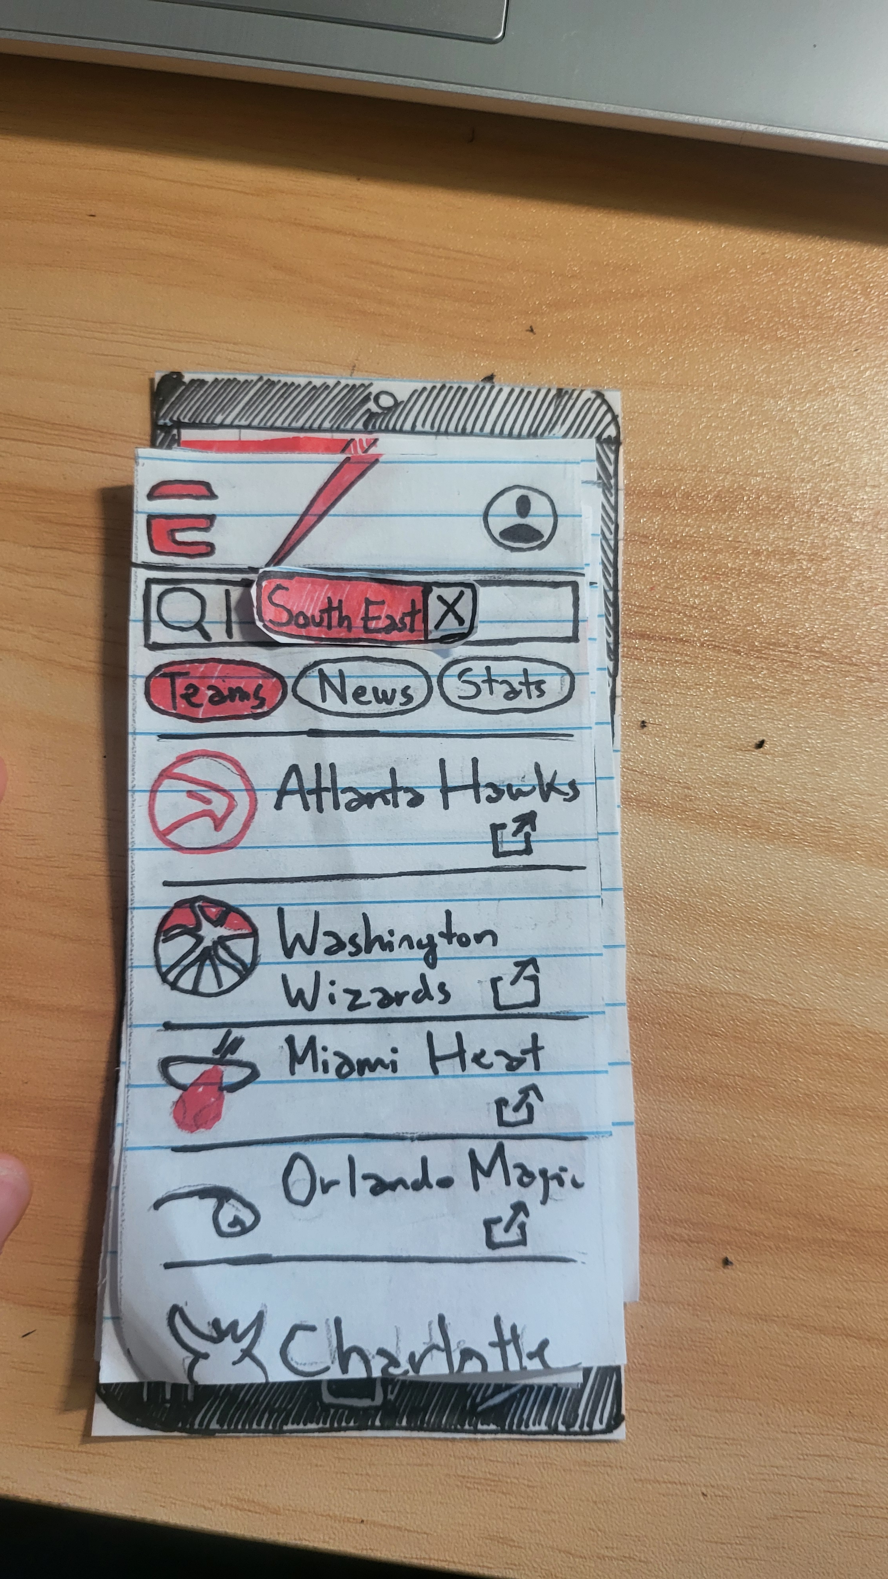
PHASE 1
Prototyping helps to make the step by step actions users will face when navigating through the app.
In this example I made a search bar element for the user to type. In the second slide it shows the user input in the search bar.

Slide 6
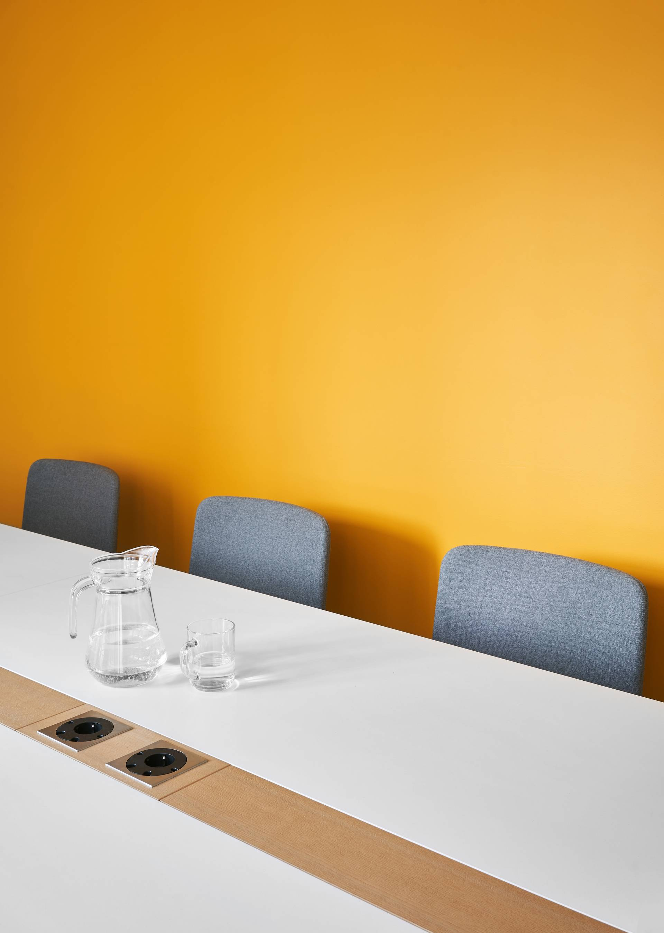
Digital wireframe + USER feedbacks

Slide 7
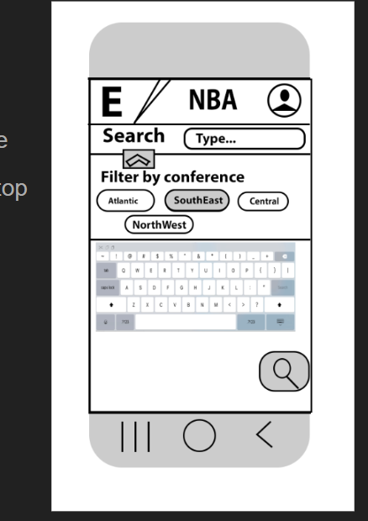
Digital wireframe
The next step is to shift from paper prototype to a digital wireframe. This allows me to envision what the changes would look like from the end user. Ultimately , the app is on a digital screen, so it solidifies our process smoothly to the correct platforms.
Focus on making digital specific elements and thinking about general layout design.

Slide 8
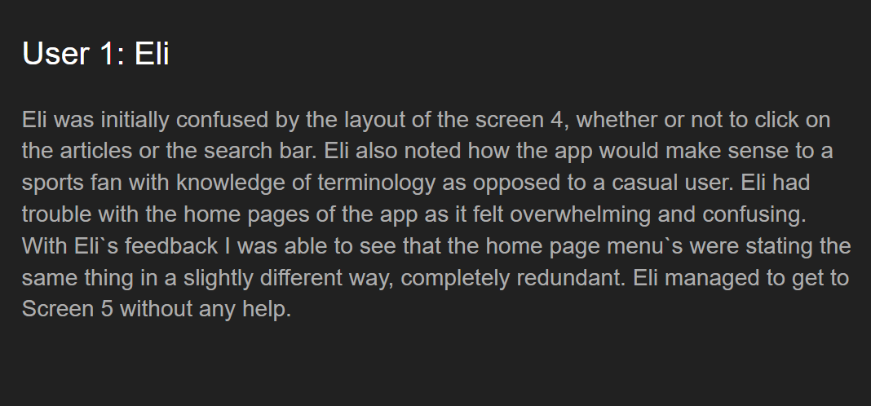
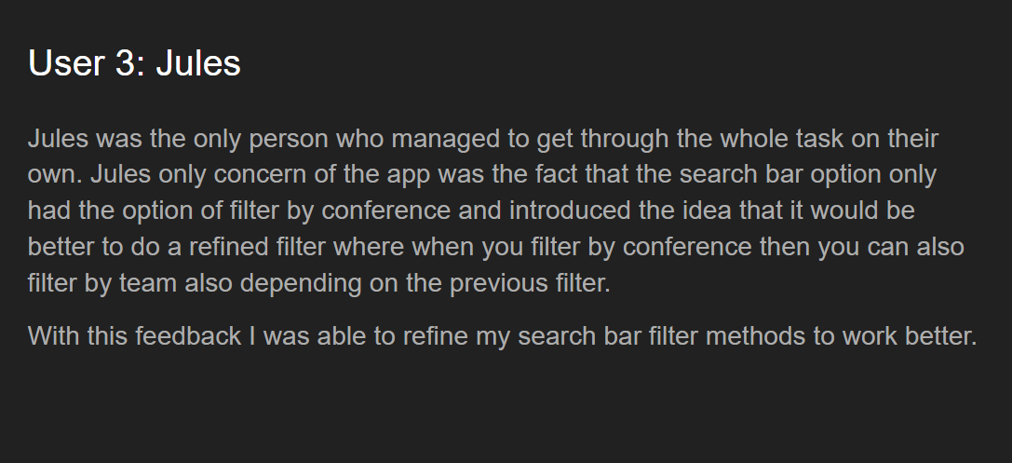
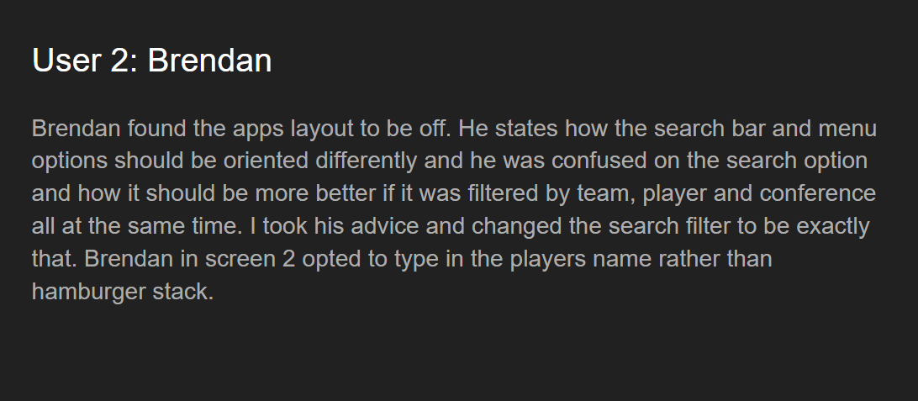
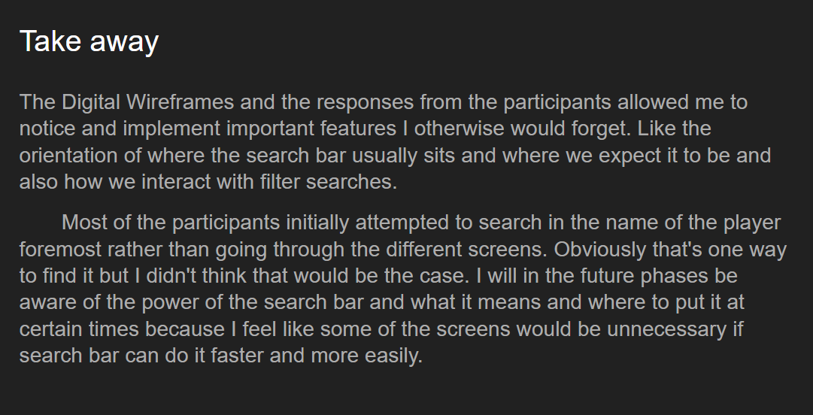
USER FEEDBACK + IMPROVEMENT

Slide 9
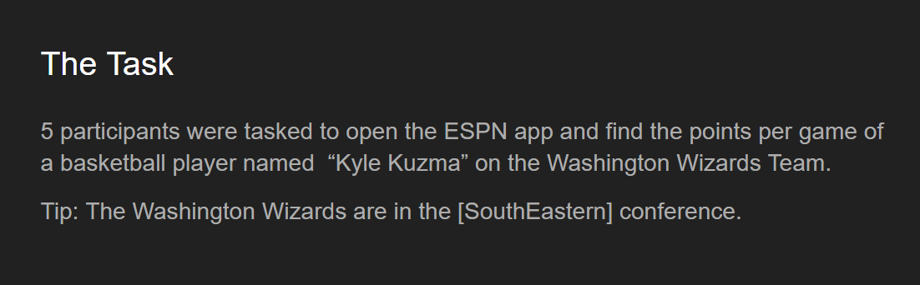
FEEDBACK+IMPROVEMENT
User input and feedback helped me immensely in the reiteration and improvement of my redesign. I had 5 participants volunteer in this survey where they are tasked to get to the certain page as shown on the top image above.
Having participants come into this project with a naked eye gave me insight I’ve never could’ve realized from my own bias. I feel first impressions are where 90% of constructive feedback should be focused upon.
In the survey I noted down where users tend to navigate and click more than other features. I jotted down where their attention and eye went to and confusions. Using feedback is the best way to improve and I’ve learned it through this project very well.

Slide 10
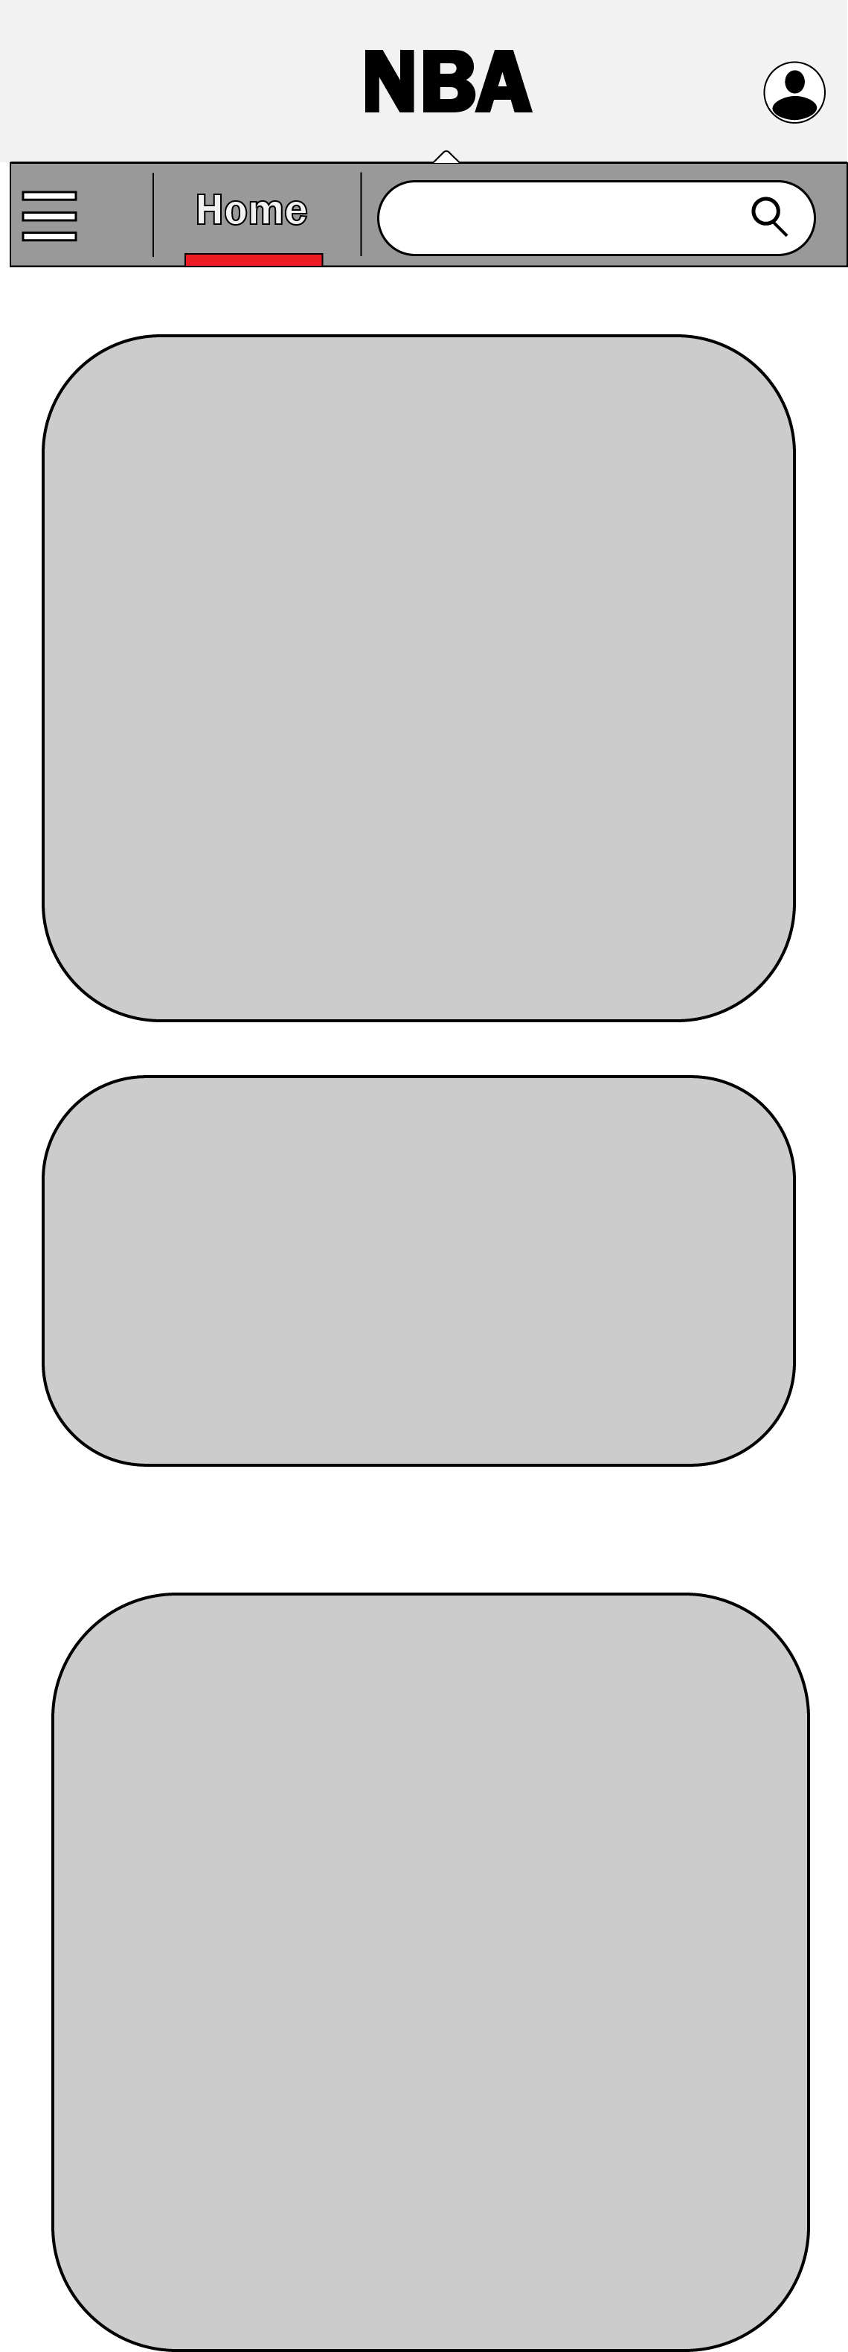
PHASE 5 Page LAYOUT + Commitment
Phase 5 takes the constructive feedback from users and improves upon the past version to create a better user-friendly layout. This stage should also solidify the fundamental elements and page navigations of the process.
This phase should give clear idea of the grid layout and overall design aspect of the project since the user experience makes sense

Slide 11
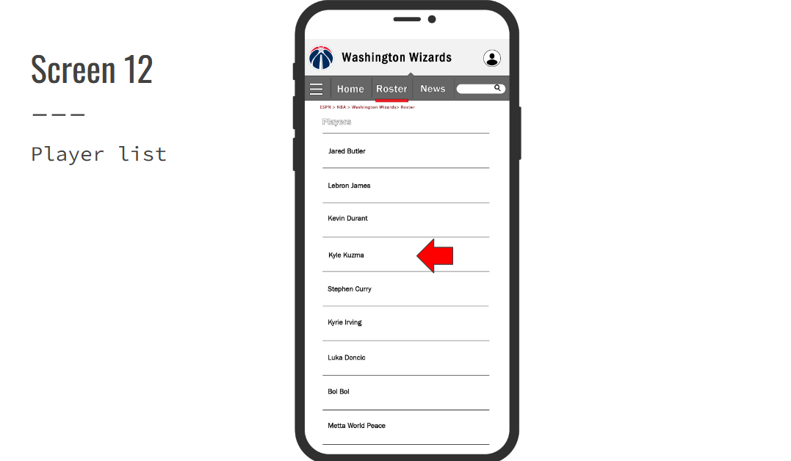
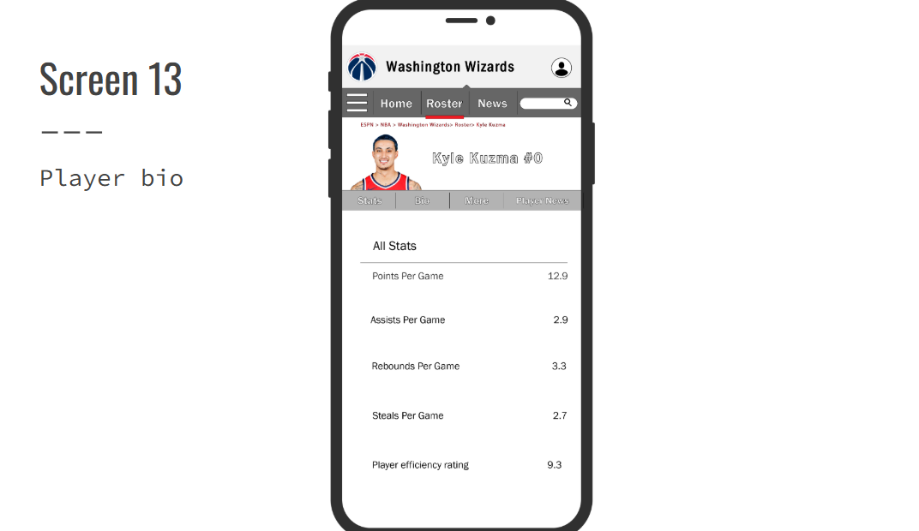
PHASE 6 final product Showcase
The final Phase, should have both the user experience elements such as: navigation, clear hierarchy of importance, demographics etc. As well as user interface elements such as aesthetics, page layout, fonts and symmetry. This is a sneak peak of what the final product looks like.

Slide 12
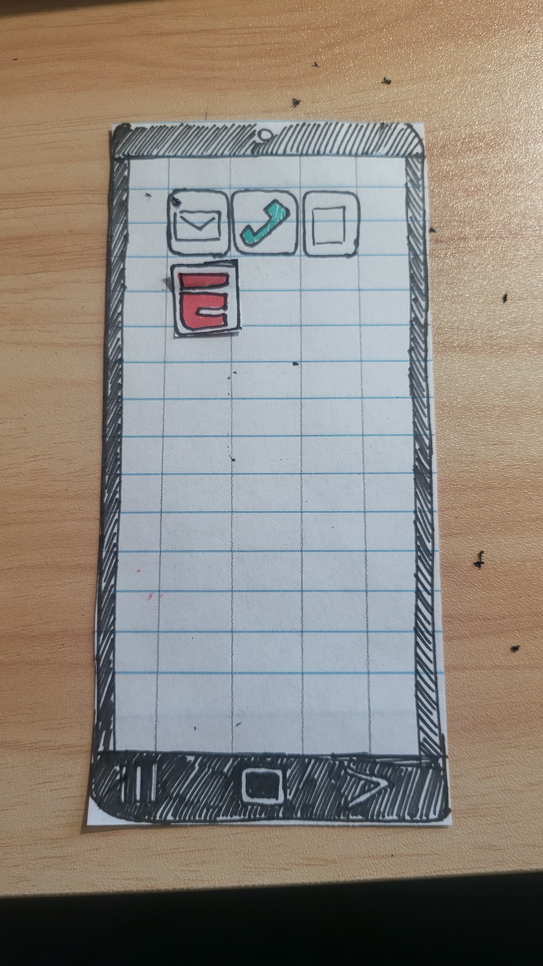
SUMMARY + TAKEAWAY
I have found that the process of redesigning an existing page and reshaping it requires a step-by-step phases that build upon each other. I realize that we can make better apps, friendly user experience by just applying what we think of it and what we can improve.
Process of reiteration not only means making it look pretty but to make it make sense above all. For a fancy page with no substance is a pretty static image.
Feedback is an immense source of improvement if taken in account to be used to make something better.
I learned that by addressing our struggles with apps that we can unlock the potential to make it better through collaborative efforts and feedback loops from each other.

Slide 13
Thank you
Uskuu Batchuluun
208-761-0701 | Uskuu Batchuluun | Game Dev student
ushukchuluun@gmail.com

